Slide 1

Presented By:
Ratnesh Kumar
B. Sc (Hons) Computer Science
Roll no: 20231432
Riya Tomar
B. Sc (Hons) Computer Science
Roll no: 20231437
A Comprehensive PPT On The
Digital Empowerment
Bridging the Gap with Technology
Submittied To :
Dr. Aakash
Assistant Professor
Department Of Operational Research

Slide 2
Introduction
Digital empowerment refers to the process of equipping individuals, businesses, and communities with the necessary digital skills, tools, and access to technology to enhance their participation in the digital world. It enables people to leverage technology for education, communication, financial transactions, governance, and innovation. Digital empowerment plays a crucial role in bridging the digital divide by ensuring equal opportunities for all, regardless of socioeconomic background or geographic location.
With advancements in digital technologies such as the internet, artificial intelligence, and cloud computing, individuals can now access vast amounts of information, improve their skills through online learning, and participate in the global economy. Governments and organizations worldwide are implementing digital literacy programs, e-governance initiatives, and digital financial services to promote inclusive growth and empower citizens.
Digital empowerment is not just about access to technology but also about the ability to use it effectively and responsibly. It fosters innovation, improves efficiency, and enhances connectivity, making it a key driver of social and economic development in the modern era.

Slide 3
Unit I: Digital inclusion and Digital Empowerment
Needs and challenges
Vision of Digital India: DigiLocker, E-Hospitals, e-Pathshala, BHIM, e-Kranti (Electronic Delivery of Services), e-Health Campaigns
Public utility portals of Govt. of India such as RTI, Health, Finance, Income Tax filing, Education

Slide 4
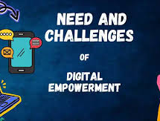
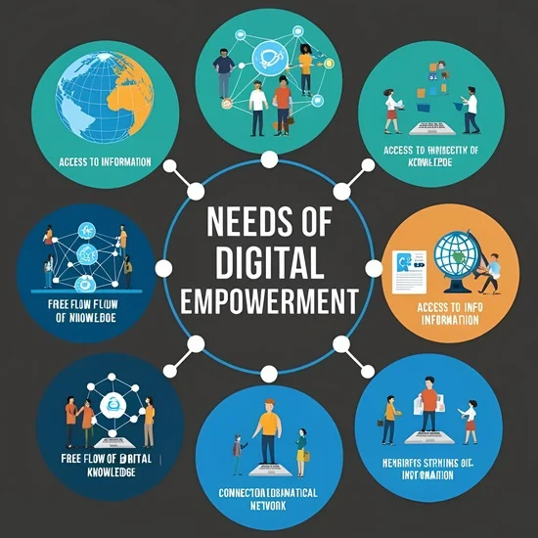
Needs Of Digital Empowerment
Digital empowerment is essential for bridging the digital divide, enhancing access to education, improving job opportunities, and enabling financial inclusion. It promotes e-governance, enhances digital literacy, and fosters innovation. With growing digital dependence, empowering individuals with technology ensures equal participation, economic growth, and social development in a rapidly evolving world.

Slide 5
Access To Information
Access to information is crucial for empowerment, enabling individuals to make informed decisions. Digital platforms provide real-time data on education, healthcare, jobs, and governance. Online libraries, news portals, and open-access resources expand learning opportunities. However, misinformation, digital illiteracy, and the digital divide pose challenges. Many rural communities lack stable internet access, limiting their ability to utilize digital resources effectively. Governments and organizations must promote digital literacy and expand internet infrastructure to ensure equal access. With responsible use of digital platforms, people can enhance their knowledge, participate in democracy, and improve their economic prospects. Future advancements in AI and blockchain can further enhance transparency and accessibility, ensuring reliable and inclusive digital access for all. Strengthening digital inclusion efforts is essential for an informed and empowered society.

Slide 6
Education & Skill Development
Digital technology has revolutionized education, making learning more accessible and flexible. Online platforms like Coursera, Khan Academy, and SWAYAM provide free and paid courses in various fields. Virtual classrooms, e-books, and video lectures eliminate geographical barriers, enabling students to learn anytime, anywhere. Skill development is equally important, with online courses in AI, cybersecurity, and digital marketing helping individuals stay relevant in a changing job market. However, challenges like digital illiteracy, lack of internet access, and affordability remain. Governments should invest in digital infrastructure, provide subsidized resources, and integrate technology-driven education in schools. Digital literacy from an early age will help future generations thrive in the digital economy. With the right support, digital education can transform societies, making learning inclusive and future-ready.

Slide 7
Economic Opportunities
Digital empowerment unlocks economic opportunities, fostering entrepreneurship and employment. E-commerce platforms like Amazon and Flipkart enable small businesses to reach global markets, while freelancing websites like Upwork offer remote work options. Digital banking and fintech solutions like BHIM UPI provide financial inclusion, making transactions easier. However, digital illiteracy, cybersecurity risks, and lack of financial awareness hinder growth. Many individuals, especially in rural areas, are unaware of online job opportunities or e-commerce benefits. Governments must promote digital financial literacy, expand internet connectivity, and support startups with funding and mentorship. Encouraging careers in digital fields like software development and cybersecurity will strengthen the digital economy. With the right policies, digital empowerment can create jobs, reduce poverty, and drive economic growth worldwide.

Slide 8
Civic Participation
Digital empowerment enhances civic participation by allowing citizens to engage with governance more effectively. E-governance platforms like RTI Portal, MyGov, and online grievance redressal systems make government services accessible. Social media enables activism, awareness campaigns, and policy discussions. Online voting, live-streamed meetings, and digital consultations promote transparency and accountability. However, misinformation, cyber threats, and digital exclusion remain challenges. Many people lack access to digital platforms, limiting participation. Cybersecurity risks, such as data breaches, further deter engagement. Governments must invest in digital literacy programs, regulate misinformation, and ensure inclusive digital access. A digitally empowered society strengthens democracy, fosters accountability, and allows every citizen to contribute to national development. Ensuring responsible digital engagement will lead to a more transparent and participatory governance system.

Slide 9
Social Connection
The digital revolution has transformed social interactions, enabling instant global communication. Social media platforms like WhatsApp, Facebook, and Instagram help people stay connected. Video conferencing tools like Zoom and Google Meet facilitate remote work, online education, and virtual events. Online forums and support groups create communities for shared interests and mental health support. However, excessive screen time, cyberbullying, and misinformation can negatively impact mental well-being. Digital addiction and online harassment are growing concerns, particularly among teenagers. To ensure a balanced digital-social life, promoting responsible social media use, digital well-being education, and stronger cybersecurity measures is essential. Encouraging real-life social interactions alongside digital communication fosters meaningful relationships. A well-connected society, both online and offline, leads to better collaboration, mental health, and social inclusivity.

Slide 10
Language & Cultural Inclusivity
Language and cultural inclusivity are key to making digital empowerment accessible to all. Many digital platforms operate in English, creating barriers for non-English speakers. AI-driven tools like Google Translate and regional-language websites help bridge the gap. Governments promote multilingual e-governance services to ensure digital accessibility for diverse populations. Cultural inclusivity involves representing different traditions, values, and languages online. Challenges include limited translation technology for various dialects and biases in AI-driven language models. Investments in AI, NLP (Natural Language Processing), and localized content creation are necessary. Inclusive digital spaces allow more people to access information, education, and job opportunities. Prioritizing linguistic and cultural diversity in digital platforms ensures equal participation and empowers all communities in the digital world.

Slide 11
Need For Digital Inclusion & Empowerment
Digital inclusion ensures equal access to technology, bridging gaps in education, jobs, and governance. Many people, especially in rural areas, lack internet access and digital skills, limiting opportunities. Without inclusion, essential services like e-learning, telemedicine, and online banking remain out of reach.
Digital empowerment goes beyond access—it involves teaching people how to use digital tools effectively. Governments and organizations must invest in internet expansion, affordable devices, and digital literacy programs. Initiatives like DigiLocker, e-Hospitals, and e-Pathshala help promote inclusion. A digitally inclusive society enables better education, economic growth, and civic participation, ensuring no one is left behind in the digital era.

Slide 12

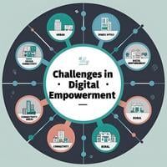
Challenges In Digital Empowerment
Digital empowerment faces challenges such as the digital divide, limited internet access in rural areas, and lack of digital literacy. Cybersecurity threats, data privacy concerns, and affordability of digital devices further hinder progress. Additionally, inadequate infrastructure and resistance to technological adoption slow down efforts to achieve inclusive digital transformation.

Slide 13
Digital Divide
The digital divide refers to the gap between those who have access to digital technology and those who do not. Factors such as income, geography, and infrastructure contribute to this divide, with rural and economically disadvantaged communities often lacking stable internet access and digital devices. Without access, individuals miss out on online education, job opportunities, and essential services like e-governance and telemedicine. Bridging this gap requires investments in affordable internet services, mobile connectivity, and digital literacy programs. Governments and private sectors must collaborate to ensure universal access, making technology a tool for empowerment rather than exclusion.

Slide 14
Limited Digital Literacy
Having access to technology is not enough—people must also know how to use it effectively. Many individuals, particularly in developing regions, lack the skills to navigate digital platforms safely and efficiently. This limits their ability to apply for jobs, access online education, or utilize e-governance services. Elderly populations and rural communities are particularly affected. Digital literacy programs in schools, workplaces, and community centers can help bridge this gap. Governments should promote structured training programs, ensuring that people of all ages can participate in the digital economy.

Slide 15
Affordability
High costs of internet services, smartphones, and computers prevent many people from accessing digital resources. Low-income families often struggle to afford the technology needed for education, work, or healthcare. Subscription fees for online learning platforms or professional tools further widen the accessibility gap. Governments can address this by providing subsidies, tax benefits, and public Wi-Fi access. Non-profits and tech companies should also collaborate to create affordable solutions, ensuring that digital empowerment is within everyone’s reach.

Slide 16
Infrastructure
Reliable internet and electricity are fundamental for digital empowerment, but many regions still lack the necessary infrastructure. Poor connectivity in rural areas, frequent power cuts, and lack of proper digital facilities hinder progress. Even in urban areas, internet speeds can be inconsistent, affecting remote work, education, and business operations. Investment in fiber-optic networks, satellite internet, and renewable energy solutions is essential for expanding infrastructure. Governments must work with private telecom companies to improve network coverage, ensuring that digital access is reliable and widespread.

Slide 17
Gender & Social Disparities
Women and marginalized communities often face greater barriers in digital access due to societal norms, economic challenges, and educational disparities. In many regions, women have lower digital literacy and are less likely to own personal devices, limiting their participation in online learning and job opportunities. Social prejudices further restrict certain communities from accessing digital platforms. Addressing these inequalities requires targeted initiatives such as digital literacy programs for women, financial support for disadvantaged groups, and awareness campaigns promoting equal access.

Slide 18
Inclusive Design
Many digital platforms are not designed to accommodate individuals with disabilities or those from diverse linguistic and cultural backgrounds. Websites and apps often lack accessibility features like screen readers, voice commands, and multilingual support. This limits participation for people with visual impairments, motor disabilities, or those who speak regional languages. Tech companies must prioritize inclusive design by incorporating universal accessibility standards, ensuring that digital spaces are welcoming to all.

Slide 19
Misinformation & Fake News
The rapid spread of misinformation and fake news is a major challenge in digital empowerment. False information on social media and messaging platforms can lead to political unrest, public health crises, and financial scams. Many people lack the skills to differentiate between credible and misleading sources. Governments and social media companies must work together to regulate content, promote fact-checking initiatives, and educate users on media literacy. Encouraging responsible content sharing can help combat misinformation.

Slide 20
Digital Dependency
While digital tools improve efficiency and connectivity, excessive dependence on technology can have negative consequences. Over-reliance on online services reduces face-to-face interactions, impacts mental health, and increases screen time-related health issues. Businesses and individuals may also become vulnerable to cyber threats if they depend entirely on digital infrastructure. Encouraging a balanced approach—where digital tools complement, rather than replace, real-world interactions—is essential for long-term well-being.

Slide 21
Digital Security & Privacy
As more activities shift online, concerns over data privacy and cybersecurity grow. Cybercrime, hacking, and identity theft pose significant threats to individuals and businesses. Many users lack awareness about securing their personal information, making them vulnerable to phishing attacks and fraud. Governments and organizations must strengthen cybersecurity laws, promote digital safety awareness, and encourage secure online practices like two-factor authentication and data encryption. A strong cybersecurity framework is crucial for trust in digital systems.

Slide 22
Resistance To Change
Adopting new digital technologies often faces resistance, especially from individuals and businesses accustomed to traditional systems. Fear of job displacement, lack of technical skills, and skepticism toward digital transformation slow down progress. Many small businesses, for example, hesitate to shift to online payment systems or e-commerce due to unfamiliarity. Awareness campaigns, skill-building initiatives, and demonstrating the benefits of digital tools can help ease this transition, ensuring that technology adoption is smooth and beneficial for all.

Slide 23
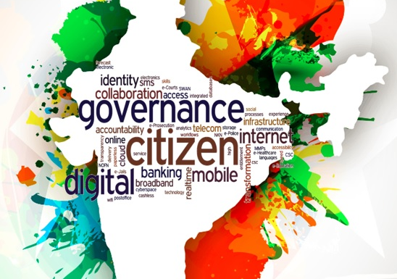

Vision Of Digital India
The vision of Digital India is to transform India into a digitally empowered society and knowledge economy. Launched in 2015, the initiative aims to enhance digital infrastructure, improve online governance, and ensure universal digital literacy. It focuses on e-governance, financial inclusion, digital empowerment, and seamless connectivity to drive socio-economic development.

Slide 24
DigiLocker
Initiated Year : 2015
Purpose: Launched under the Digital India initiative, DigiLocker provides a secure cloud-based platform for storing and accessing important government-issued documents.
Features: It allows users to store Aadhaar, PAN, driving licenses, educational certificates, and other official records digitally. It ensures paperless governance and eliminates the need for physical document verification.

Slide 25
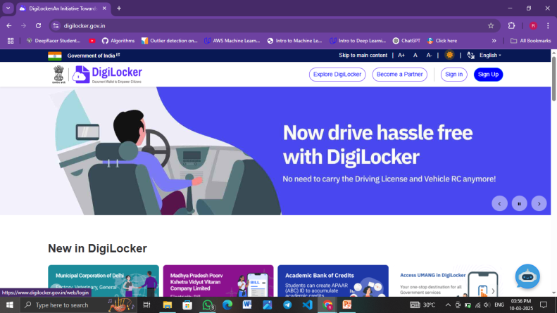
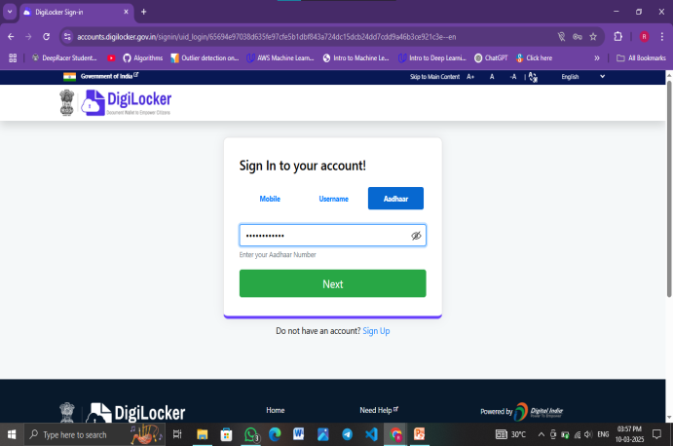
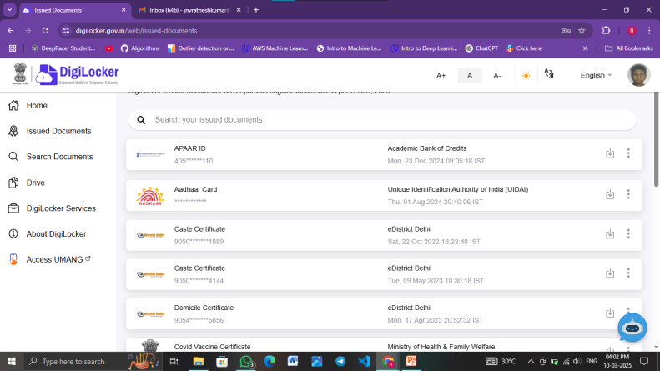
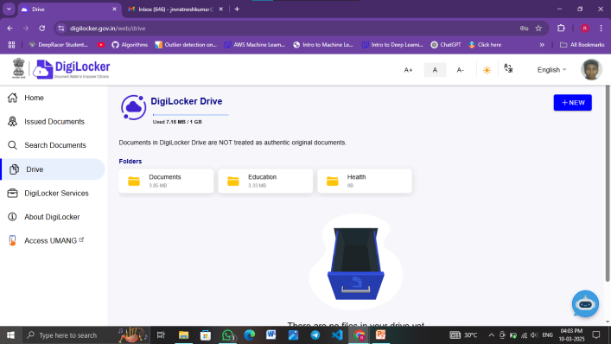
DigiLocker

Slide 26
E-Hospitals
Initiated Year : 2015
Purpose: This is an online hospital management system developed by NIC (National Informatics Centre) to digitalize healthcare services in government hospitals.
Features: It offers online appointment booking, patient registration, doctor consultation history, and digital prescriptions. The system improves hospital efficiency and enhances patient experience.

Slide 27
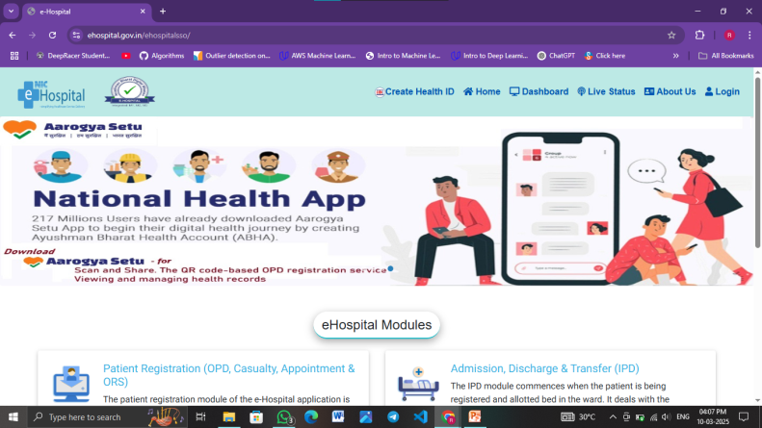
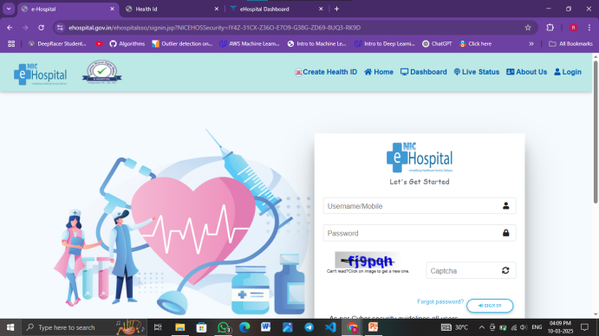
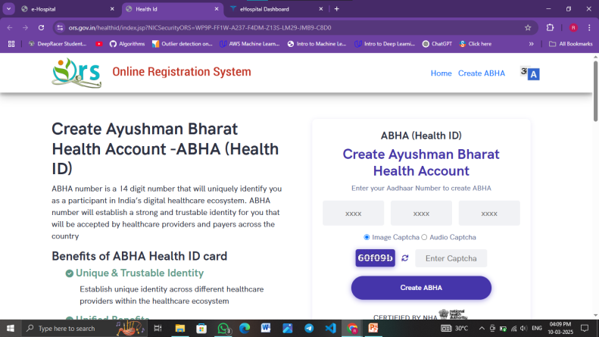
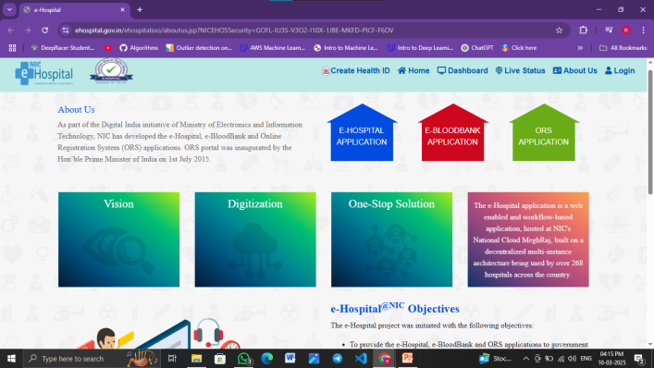
E-Hospitals

Slide 28
E-Pathshala
Initiated Year : 2015
Purpose: Developed by NCERT, E-Pathshala is an educational initiative to provide free digital learning resources to students and teachers.
Features: The platform provides e-books, audio-visual content, and interactive study materials for various subjects. It enhances remote learning and makes education accessible to all.

Slide 29
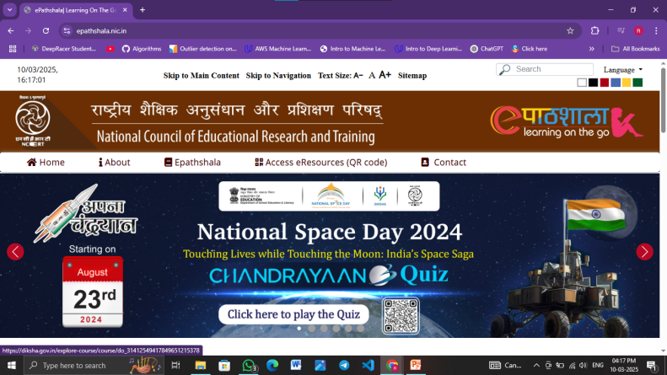
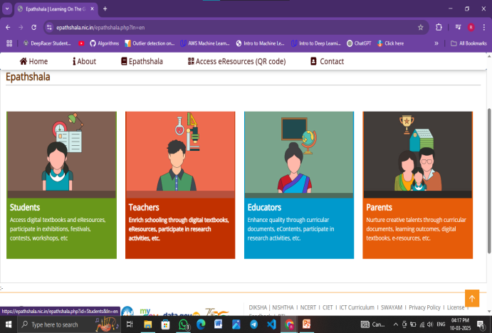
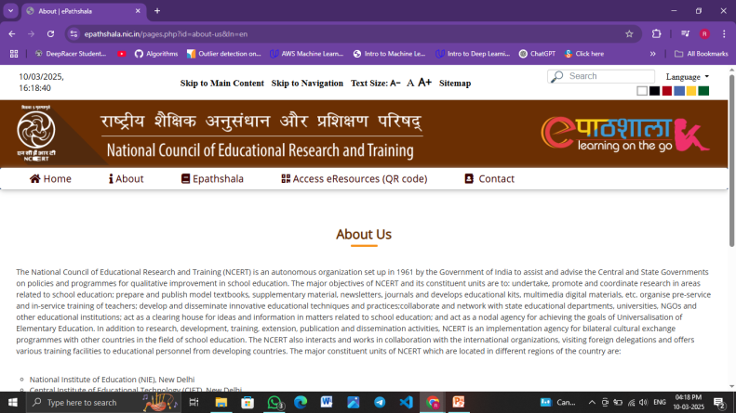
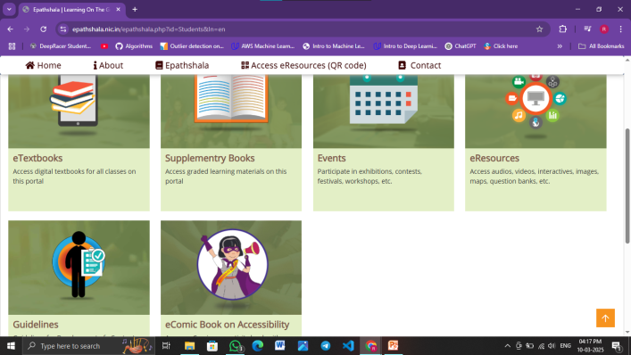
E-Pathshala

Slide 30
BHIM (Bharat Interface for Money)
Initiated Year : 2016
Purpose: BHIM is a mobile payment application developed by NPCI to promote cashless transactions using UPI (Unified Payments Interface).
Features: It enables direct bank-to-bank transfers using UPI ID, mobile number, or QR codes. It ensures fast, secure, and seamless digital payments without the need for intermediaries.

Slide 31
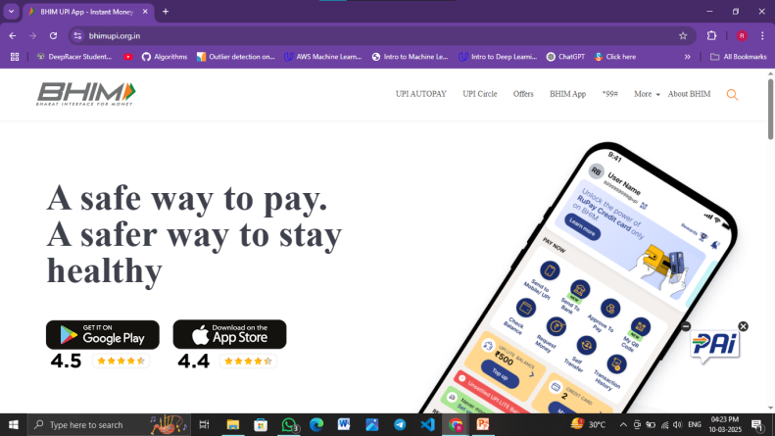
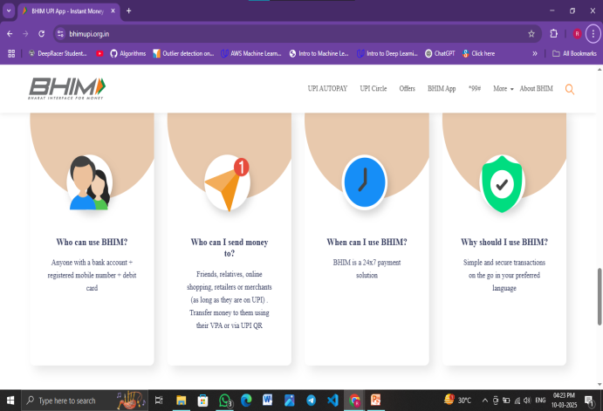
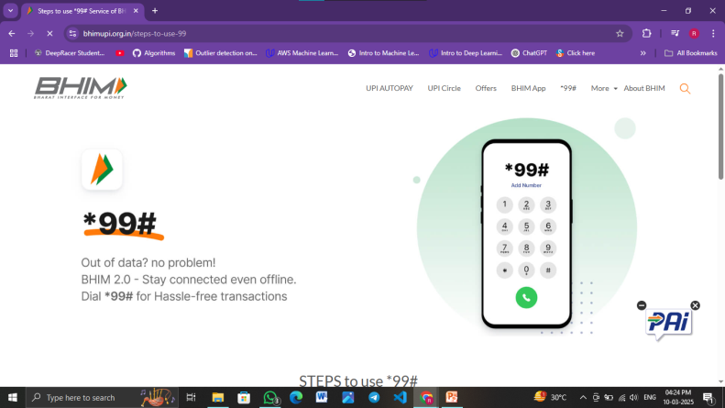
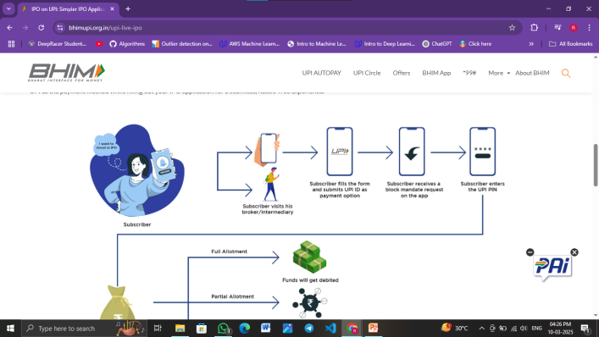
BHIM (Bharat Interface for Money)

Slide 32
E-Kranti
Initiated Year : 2015
Purpose: E-Kranti is a part of the Digital India program aimed at improving e-governance and digital infrastructure.
Features: It focuses on providing digital services in various sectors, including healthcare, education, and governance. It promotes transparency, efficiency, and accessibility in government services.

Slide 33
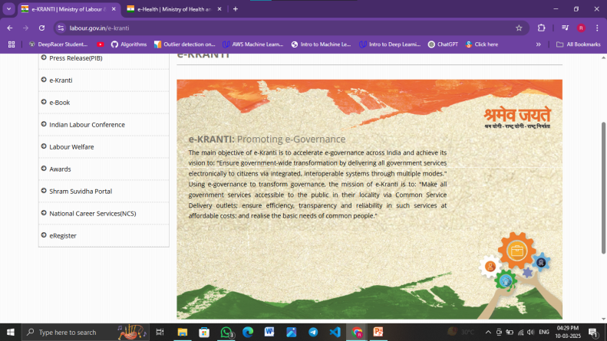
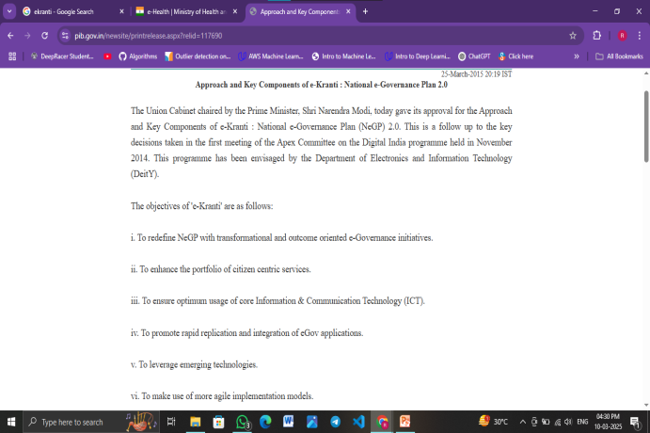
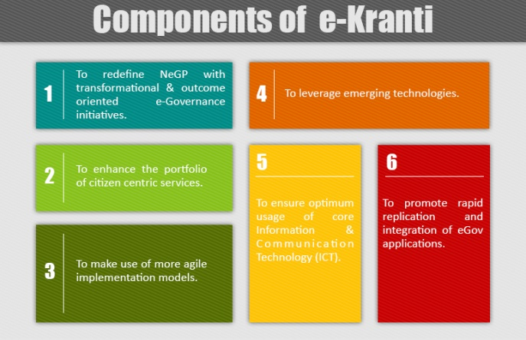

E-Kranti

Slide 34
E-Health Campaigns
Initiated Year : 2015
Purpose: These campaigns were launched to integrate digital technology into healthcare and improve health awareness.
Features: They provide telemedicine, digital health records, and online medical consultations. They enhance healthcare accessibility, especially in rural and underserved areas.

Slide 35
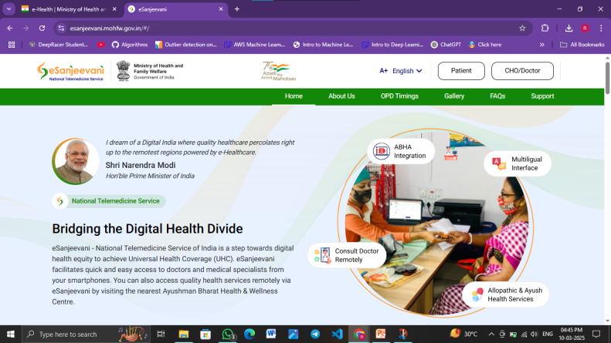
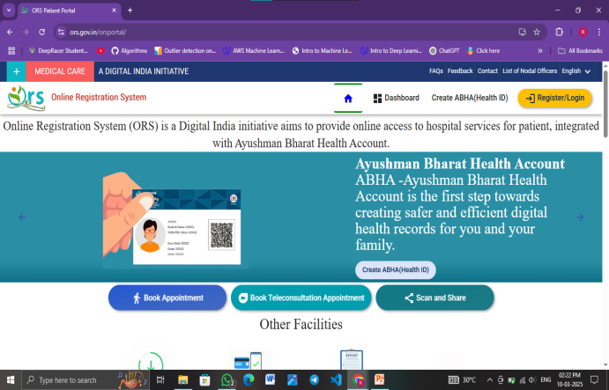
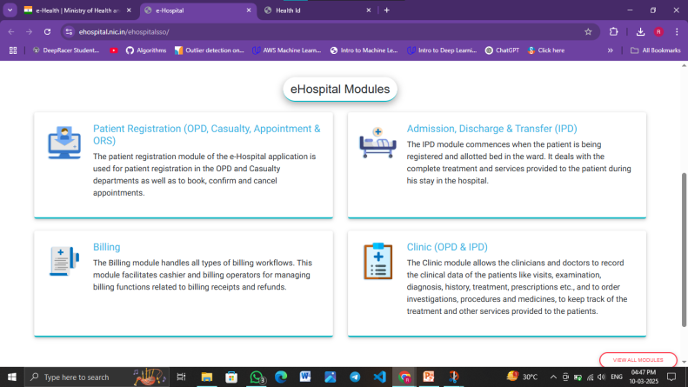
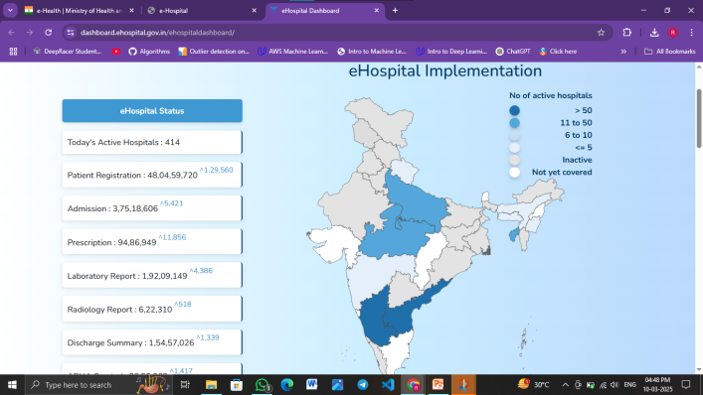
E-Health Campaigns

Slide 36

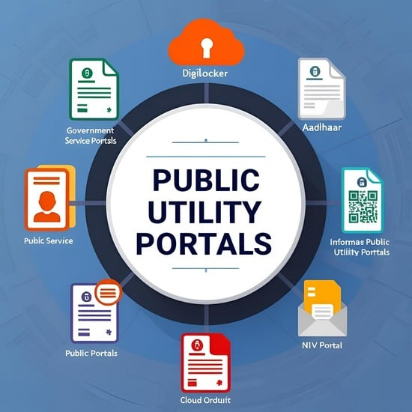
Public Utility Portals
Public utility portals are government or private digital platforms that provide essential services like bill payments, healthcare, education, and financial transactions. These portals ensure easy access to services such as electricity, water, gas, and transport. They enhance transparency, reduce paperwork, and improve convenience, making public services more efficient and accessible.

Slide 37
RTI Portal
Initiated Year: 2013
Purpose: The RTI (Right to Information) Portal enables Indian citizens to access government information, promoting transparency and accountability.
Features: Users can file RTI applications online, track their requests, and receive responses from public authorities. It helps curb corruption and enhances public participation in governance.

Slide 38
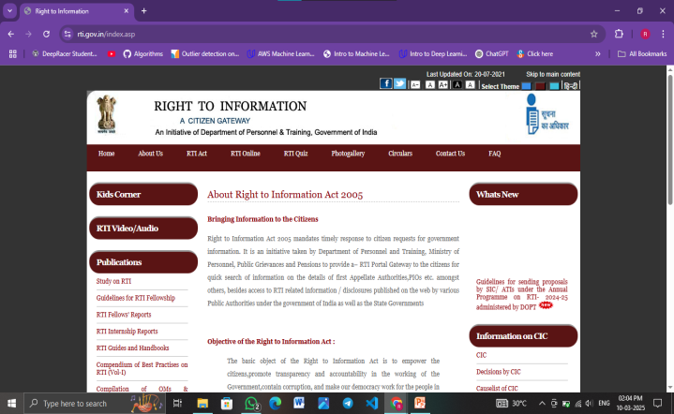
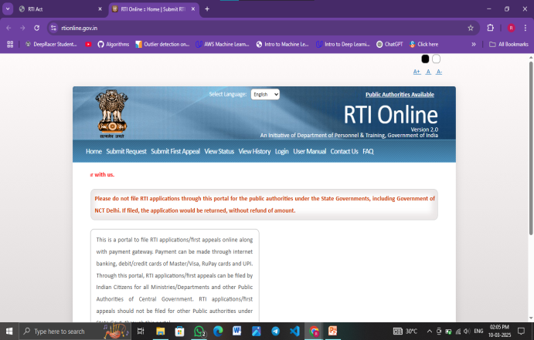
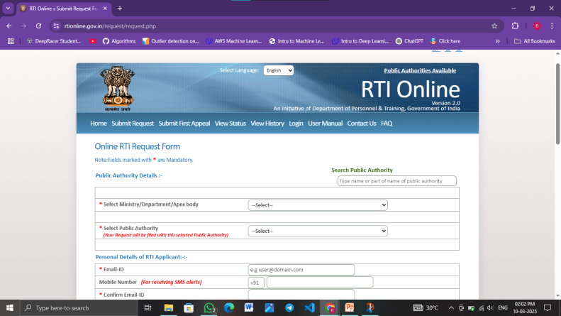
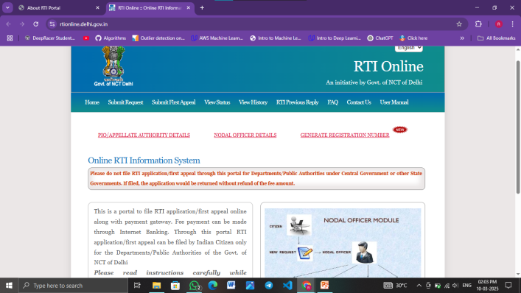
RTI Portal

Slide 39
Health Portal
Initiated Year: 2014
Purpose: The Health Portal provides centralized access to healthcare services, medical records, and government health initiatives.
Features: It includes online access to hospital services, telemedicine consultations, vaccination records, and health scheme details. It enhances healthcare accessibility, particularly in rural and remote areas.

Slide 40

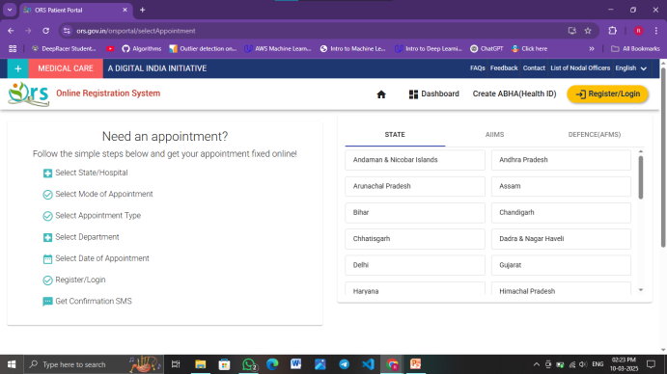
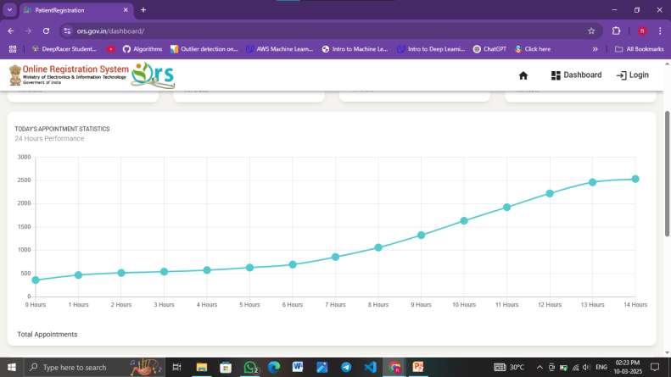
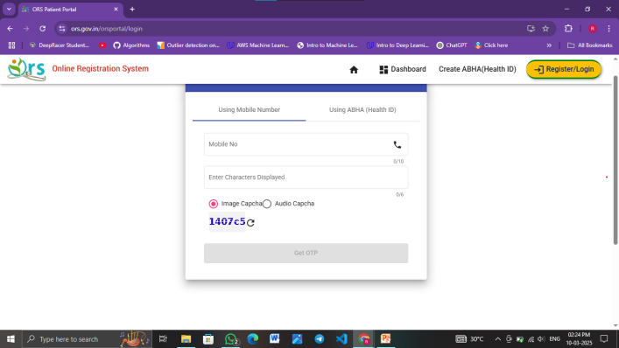
Health Portal

Slide 41
Finance Portal
Initiated Year: 2015
Purpose: The Finance Portal offers a one-stop platform for financial services, economic policies, and investment-related information.
Features: Users can access government financial schemes, track subsidies, apply for loans, and get tax-related information. It helps individuals and businesses make informed financial decisions.

Slide 42
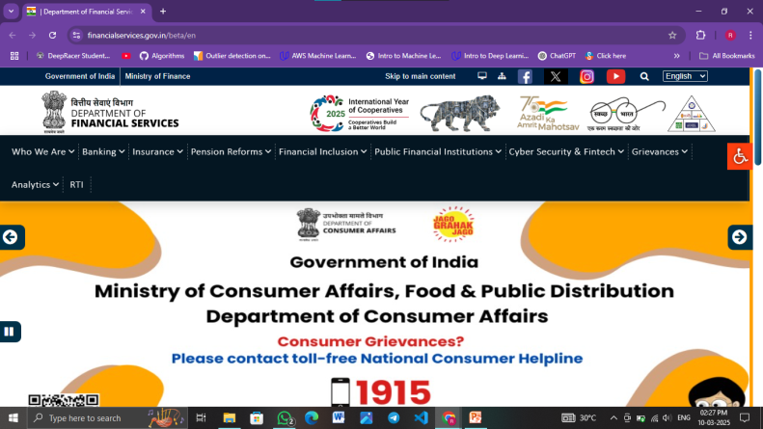
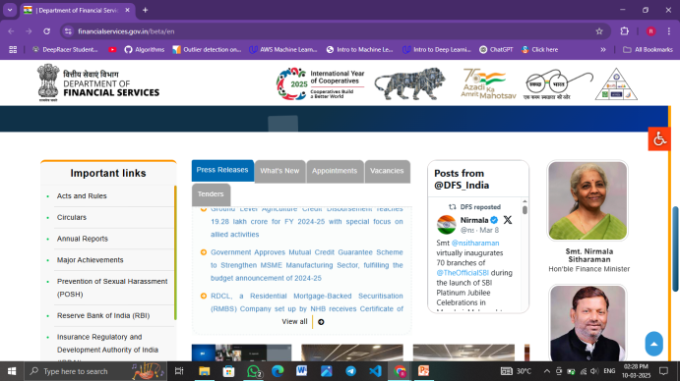
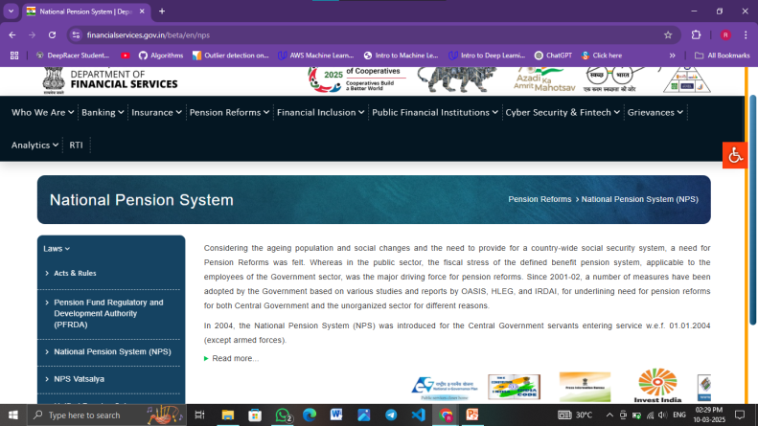
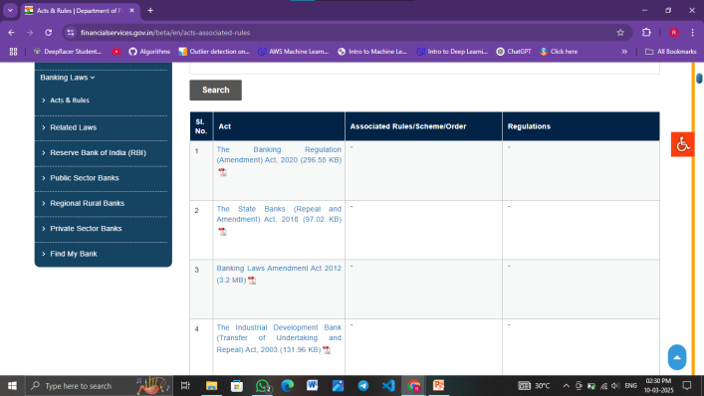
Finance Portal

Slide 43
Income Tax Filing Portal
Initiated Year: 2006 (Revamped in 2021)
Purpose: This portal simplifies income tax filing and compliance, making tax-related processes more efficient for individuals and businesses.
Features: It enables e-filing of tax returns, tracking of refund status, tax computation, and access to tax-saving guidance. It reduces paperwork, ensures transparency, and speeds up tax processing.

Slide 44
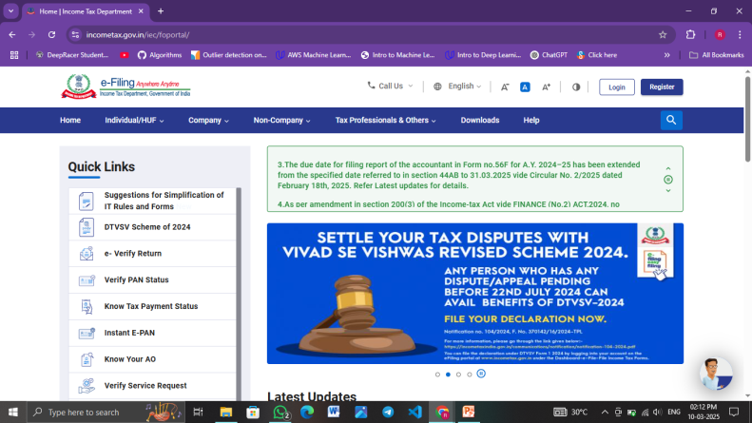
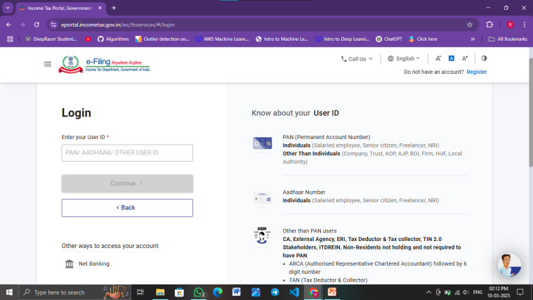
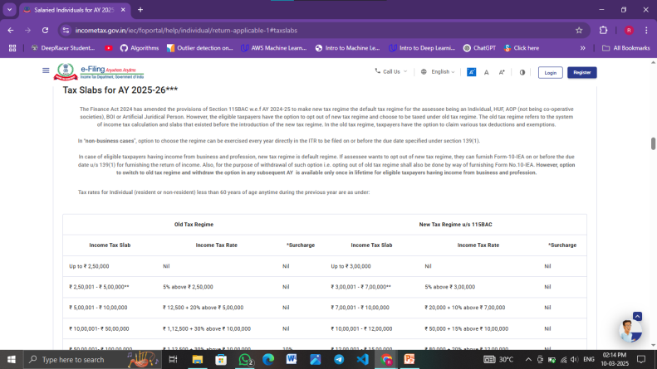
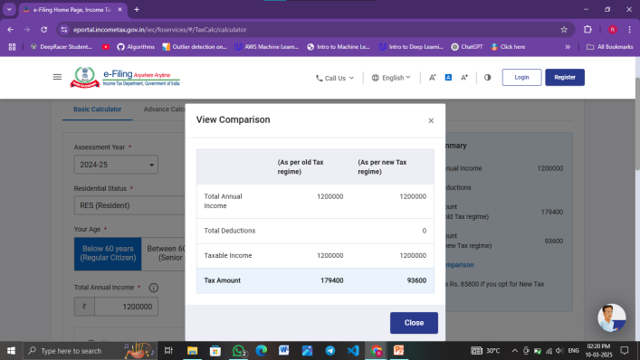
Income Tax Filing Portal

Slide 45
Education Portal
Initiated Year: 2015
Purpose: The Education Portal provides digital learning resources and academic services for students, teachers, and institutions.
Features: It offers e-books, online courses, examination results, scholarships, and admission-related details. The portal promotes digital education and ensures wider access to academic resources.

Slide 46
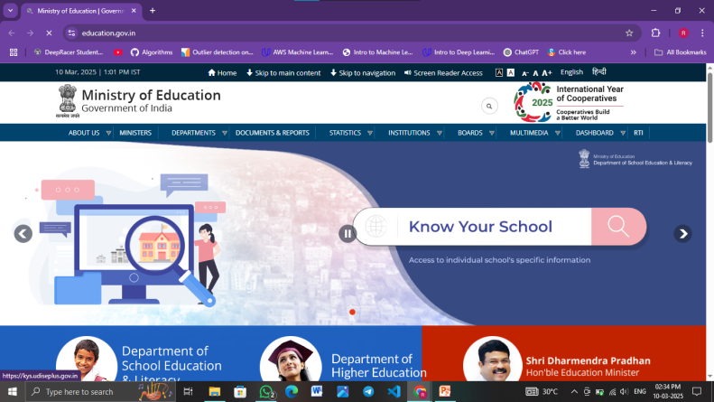
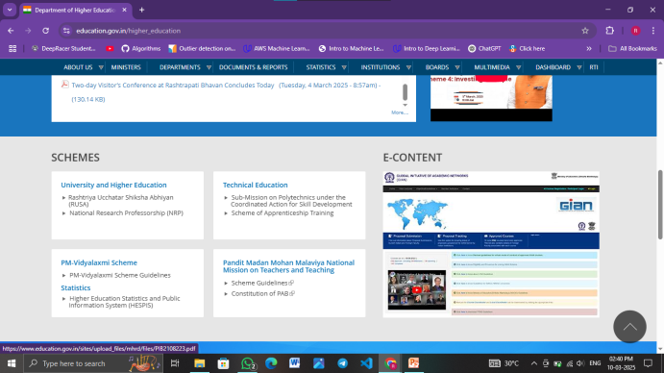
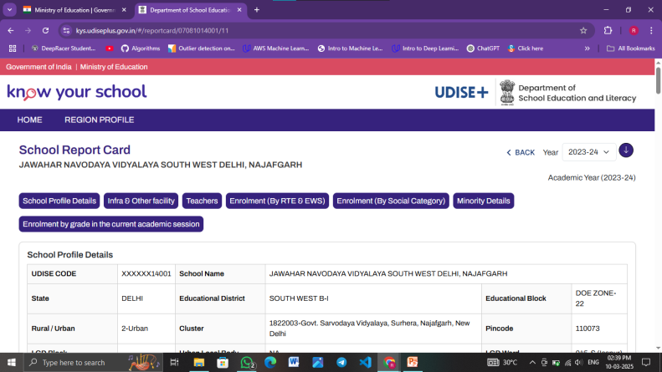
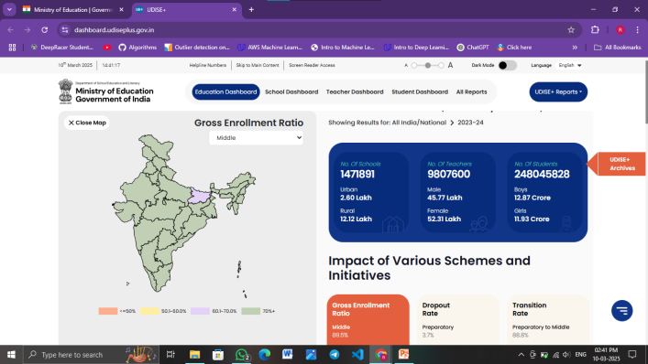
Education Portal

Slide 47
Unit II: Communication and Collaboration in the Cyberspace
Electronic Communication: electronic mail, blogs, social media
Collaborative Digital platforms
Tools/platforms for online learning
Collaboration using file sharing, messaging, video conferencing

Slide 48


Electronic Communication
Electronic communication refers to the exchange of information using digital technologies such as emails, social media, messaging apps, and video conferencing. It enables fast, efficient, and global communication, reducing dependency on traditional methods like postal mail. Electronic communication enhances business collaboration, education, and personal interactions, making connectivity more seamless and accessible.

Slide 49
Email
Email (Electronic Mail) is a widely used digital communication tool that allows individuals and businesses to send and receive messages over the internet. It is essential for professional and personal communication due to its speed and efficiency. Email enables users to share text, images, documents, and other attachments securely. It also includes features like spam filters, folders for organizing messages, and encryption for secure communication. In the business world, email is crucial for official correspondence, marketing, and customer engagement.

Slide 50
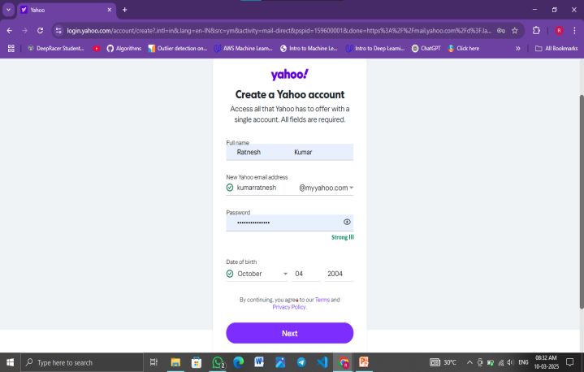
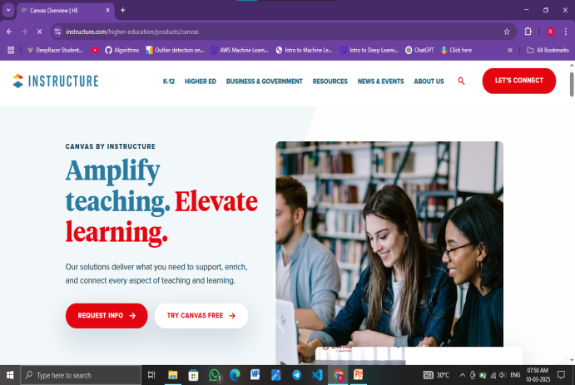
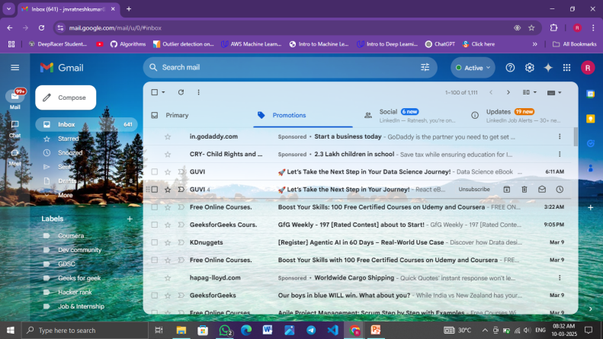

Email

Slide 51
Blogs
A blog is an online platform where individuals or organizations publish written content on various topics. Blogs can be personal diaries, professional insights, news articles, or educational resources. They allow writers to express opinions, share knowledge, and engage with readers through comments and discussions. Blogs play a key role in digital marketing, helping businesses attract audiences and improve search engine rankings. Popular blogging platforms include WordPress, Blogger, and Medium. The interactive nature of blogs makes them a powerful tool for information sharing and community building.

Slide 52




Blogs

Slide 53
Social Media
Social media platforms like Facebook, Instagram, and LinkedIn enable users to connect, share content, and communicate with a global audience. Social media is widely used for networking, entertainment, news updates, and business promotions. It allows users to post text, images, videos, and live streams, making it a highly interactive space. Businesses use social media for brand promotion, customer engagement, and advertising. The real-time nature of social media makes it a vital tool for spreading information, awareness, and entertainment across various communities.

Slide 54




Social Media

Slide 55


Collaborative Digital Platforms
Collaborative digital platforms enable multiple users to work together in real time, regardless of location. These platforms, such as Google Workspace, Microsoft Teams, and Slack, support file sharing, communication, and project management. They enhance productivity, streamline workflows, and facilitate teamwork in businesses, education, and remote work environments.

Slide 56
Slack
Slack is a team communication and collaboration platform designed to streamline workplace conversations. It allows users to create channels for different teams or projects, ensuring organized discussions. Slack supports direct messaging, file sharing, and integration with various productivity tools like Google Drive and Trello. It enhances real-time collaboration with features like voice and video calls, reducing reliance on emails for internal communication.

Slide 57




Slack

Slide 58
Microsoft Teams Collaboration
Microsoft Teams is an all-in-one collaboration tool integrated with Microsoft 365. It enables messaging, video conferencing, file sharing, and document collaboration in real time. Users can create dedicated team workspaces for projects, ensuring smooth coordination. The platform integrates with SharePoint, OneDrive, and Outlook, making it a powerful tool for businesses and remote teams. With advanced security features, Microsoft Teams ensures safe and efficient workplace communication.

Slide 59




Microsoft Teams Collaboration

Slide 60
Google Workspace
Google Workspace (formerly G Suite) is a cloud-based productivity suite offering tools like Gmail, Google Drive, Docs, Sheets, Meet, and Calendar. It enables real-time document editing and sharing, improving teamwork efficiency. Google Workspace supports AI-powered suggestions and advanced search features, enhancing workflow automation. It is widely used in businesses and educational institutions for seamless collaboration and data management.

Slide 61




Google Workspace

Slide 62
Trello
Trello is a visual project management tool that helps teams organize tasks using boards, lists, and cards. It simplifies project tracking with an intuitive drag-and-drop interface. Users can set deadlines, assign tasks, and add labels to prioritize work. Trello integrates with various apps like Slack and Google Drive, making it ideal for agile project management. Its simplicity and flexibility make it useful for individuals, startups, and large organizations managing complex workflows.

Slide 63




Trello

Slide 64
Asana
Asana is a powerful project management tool designed for efficient task planning and execution. It offers features like project timelines, task assignments, workflow automation, and real-time reporting. Asana helps teams track progress, manage workloads, and streamline collaboration. It integrates with tools like Slack, Google Drive, and Microsoft Teams, providing a centralized workspace. With its user-friendly interface and automation capabilities, Asana is widely used for managing large-scale projects and ensuring productivity.

Slide 65




Asana

Slide 66


Tools For Online Learning
Tools for online learning include Learning Management Systems (LMS) like Moodle, Canvas, and Blackboard, which help manage courses and assignments. Video conferencing tools such as Zoom, Microsoft Teams, and Google Meet enable virtual classes. Collaboration platforms like Google Workspace and Trello support teamwork, while educational apps enhance interactive learning experiences.

Slide 67


Learning Management Systems
A Learning Management System (LMS) is a digital platform that enables the creation, management, and delivery of educational content. It facilitates online learning, tracking progress, and assessments, making education more accessible and organized for students, teachers, and organizations.

Slide 68
Moodle
Moodle (Modular Object-Oriented Dynamic Learning Environment) is an open-source learning management system (LMS) widely used in educational institutions and corporate training programs. It provides a flexible platform for online learning, offering features such as course creation, quizzes, assignments, and discussion forums. Moodle supports multimedia integration, real-time collaboration, and grading tools, making it a powerful tool for educators and students. Its open-source nature allows institutions to customize the platform to meet their specific learning needs.

Slide 69




Moodle

Slide 70
Canvas
Canvas is a cloud-based LMS designed to streamline digital learning experiences for schools, colleges, and businesses. It offers an intuitive interface, mobile compatibility, and powerful integration options with tools like Google Drive, Microsoft Office, and Zoom. Canvas includes features such as real-time collaboration, interactive quizzes, video conferencing, and automated grading. Its analytics and reporting tools help educators track student progress effectively. Canvas is widely adopted by institutions due to its ease of use and scalability.

Slide 71




Canvas

Slide 72
Blackboard
Blackboard is a comprehensive LMS designed to enhance online and blended learning experiences. It offers tools for course management, virtual classrooms, assessment creation, and interactive learning modules. Blackboard integrates with third-party applications, supports mobile learning, and provides advanced analytics for performance tracking. It also includes accessibility features, ensuring an inclusive learning environment. Universities and businesses use Blackboard for training and education due to its robust functionality and adaptability.

Slide 73




Blackboard

Slide 74


Video & Conferencing And Webinar Platforms
Video conferencing and webinar platforms play a crucial role in modern communication, enabling real-time collaboration, virtual meetings, and online events. They provide features like video calling, screen sharing, chat, recording, and integrations with productivity tools. Some of the most widely used platforms include Zoom, Microsoft Teams, and Google Meet.

Slide 75
Zoom
Zoom is one of the most popular video conferencing platforms, known for its ease of use and high-quality video and audio. It is widely used in corporate settings, education, and healthcare. Zoom offers features like HD video, screen sharing, meeting recording, and breakout rooms for group discussions. It also supports large-scale webinars with audience engagement tools such as Q&A and polls. Additionally, Zoom integrates with productivity apps like Slack and Google Calendar while ensuring secure meetings through encryption. Its simplicity and flexibility make it a preferred choice for businesses of all sizes.

Slide 76




Zoom

Slide 77
Microsoft Team
Microsoft Teams is a comprehensive collaboration platform that combines video conferencing, messaging, file sharing, and integration with Microsoft 365 applications. It is widely used in workplaces and educational institutions for remote meetings and teamwork. Microsoft Teams allows users to schedule meetings, host webinars, and collaborate on documents in real-time through seamless integration with Word, Excel, and PowerPoint. The platform organizes communication through team channels and ensures enterprise-grade security with multi-factor authentication and encryption. Its strong integration with Microsoft’s ecosystem makes it ideal for organizations already using Microsoft 365.

Slide 78




Microsoft Team

Slide 79
Google Meet
Google Meet is a secure and user-friendly video conferencing platform that is part of Google Workspace (formerly G Suite). It is commonly used for business meetings, remote learning, and virtual events. Google Meet offers features like screen sharing, real-time collaboration on Google Docs, and AI-powered live captions for accessibility. It integrates seamlessly with Gmail and Google Calendar, making scheduling and joining meetings effortless. With encrypted calls and strong privacy controls, Google Meet ensures secure communication, making it a popular choice for organizations relying on Google’s productivity tools.

Slide 80




Google Meet

Slide 81


Content Creation & Sharing
Content creation and sharing involve generating digital materials such as articles, videos, images, and presentations and distributing them across platforms. It enables knowledge sharing, marketing, and engagement through social media, websites, and learning management systems, enhancing communication and collaboration.

Slide 82
Google Classroom
Google Classroom is a free online learning platform designed to streamline content sharing between teachers and students. It allows educators to create and distribute assignments, post announcements, and facilitate discussions in a structured digital environment. The platform integrates seamlessly with Google Workspace tools like Docs, Sheets, and Slides, enabling real-time collaboration. Teachers can grade assignments, provide feedback, and track student progress within the platform. Google Classroom simplifies online learning and is widely used in schools, colleges, and training programs.

Slide 83




Google Classroom

Slide 84
Microsoft OneNote
Microsoft OneNote is a digital notebook that helps users organize notes, create to-do lists, and collaborate on projects. It supports text, images, drawings, and embedded multimedia, making it a versatile tool for students, educators, and professionals. OneNote allows users to create structured notebooks with sections and pages, ensuring efficient organization of content. It integrates with Microsoft 365, enabling users to share and edit notes in real time with team members or classmates. The platform also includes handwriting recognition and audio recording features, making it a powerful tool for capturing and sharing information.

Slide 85




Microsoft OneNote

Slide 86
Padlet
Padlet is an interactive content-sharing platform that allows users to create digital bulletin boards for collaboration and brainstorming. It supports various content types, including text, images, videos, links, and documents, making it a highly visual and engaging tool. Teachers use Padlet for interactive classroom discussions, project-based learning, and resource sharing. Businesses and teams also use it for idea generation, knowledge management, and collaborative planning. With its intuitive drag-and-drop interface and real-time updates, Padlet enhances content sharing and teamwork across different settings.

Slide 87




Padlet

Slide 88


Online Course Plateforms
An Online Course Platform enables users to create, access, and manage educational content remotely. It provides structured courses, video lectures, quizzes, and certifications. Popular platforms like Udemy, Coursera, and edX support self-paced and instructor-led learning for diverse subjects.

Slide 89
Coursera
Coursera is a well-known online learning platform that offers courses, specializations, and degrees from top universities and institutions worldwide. It provides access to subjects like business, technology, and data science, with courses from institutions like Stanford, Yale, and Google. Learners can earn certificates and even full degrees by completing accredited courses. Coursera offers both free and paid content, catering to students and professionals looking to upskill. Its flexible learning options make it suitable for career advancement and academic enrichment.

Slide 90




Coursera

Slide 91
Udemy
Udemy is a global online learning marketplace that offers a wide range of courses on topics such as programming, business, personal development, and design. Unlike university-affiliated platforms, Udemy allows instructors from around the world to create and sell their courses. With over 200,000 courses, learners can access content in multiple languages and at affordable prices. Udemy provides lifetime access to purchased courses, allowing users to learn at their own pace. The platform is widely used by individuals and companies for skill development and training.

Slide 92




Udemy

Slide 93
Khan Academy
Khan Academy is a nonprofit educational platform that provides free, high-quality courses in subjects like math, science, economics, and humanities. It is widely used by students, educators, and self-learners to improve foundational knowledge through interactive exercises and video lessons. The platform offers a personalized learning experience with progress tracking and adaptive assessments. Khan Academy is especially popular among school students and those preparing for standardized tests like SAT, GMAT, and MCAT. Its free access makes education available to learners worldwide.

Slide 94




Khan Academy

Slide 95
BYJU’S
BYJU’S is an Indian online learning platform that offers engaging video lessons, quizzes, and interactive content for school students and competitive exam preparation. It covers subjects from kindergarten to higher education, including JEE, NEET, CAT, and UPSC coaching. The platform uses AI-based personalized learning and gamified lessons to make studying more effective. With mobile app accessibility and live classes, BYJU’S provides an immersive learning experience. It is one of the leading ed-tech companies in India, catering to millions of students.

Slide 96




BYJU’S

Slide 97
Swayam
SWAYAM (Study Webs of Active Learning for Young Aspiring Minds) is a government-run online education platform in India that offers free courses from top Indian universities and institutions. It covers a wide range of subjects, including engineering, management, humanities, and law. The courses are created by professors from IITs, IIMs, and other prestigious institutions and are available for free. Learners can also opt for certification by paying a nominal fee and passing an examination. SWAYAM is part of India’s initiative to make quality education accessible to all.

Slide 98




Swayam

Slide 99


Virtual Learning Environment
A Virtual Learning Environment (VLE) is an online platform that facilitates digital education by providing tools for course management, interactive learning, and assessments. It supports collaboration through discussion forums, video lectures, and assignments, enhancing remote and blended learning experiences.

Slide 100
Idomoo
Idomoo is a unique virtual learning platform that focuses on personalized and interactive video-based learning. It allows educators and organizations to create dynamic, customized video content tailored to individual learners. The platform integrates AI and automation to generate engaging educational experiences. Idomoo is particularly useful for corporate training, e-learning courses, and onboarding programs, helping learners retain information more effectively through visual storytelling.

Slide 101




Idomoo

Slide 102
Schoology
Schoology is a widely used learning management system (LMS) designed for K-12 schools, colleges, and corporate training. It provides educators with tools to create courses, manage assignments, track student progress, and facilitate communication. The platform supports collaboration through discussion boards, messaging, and group projects. Schoology integrates with various third-party apps like Google Drive, Microsoft OneDrive, and Zoom, making it a comprehensive solution for digital classrooms.

Slide 103




Schoology

Slide 104
Seesaw
Seesaw is an interactive learning platform designed for younger students, primarily in elementary schools. It allows teachers to create engaging assignments, and students can respond using drawings, recordings, videos, and text. The platform encourages student creativity and self-expression while enabling teachers to provide real-time feedback. Seesaw also offers a parent communication feature, allowing families to stay involved in their child’s learning progress. Its intuitive interface makes it an excellent tool for blended and remote learning.

Slide 105




Seesaw

Slide 106


Collaboration Using File Sharing, Messaging, Video Conferencing
Collaboration using file sharing, messaging, and video conferencing enables seamless teamwork in remote and hybrid environments. Tools like Google Drive, Slack, and Zoom allow real-time document sharing, instant communication, and virtual meetings, improving productivity and connectivity across teams and organizations.

Slide 107


File Sharing Platforms
File sharing platforms allow users to store, access, and share digital files securely over the internet. These platforms provide cloud storage solutions with collaboration features, enabling individuals and teams to work together efficiently. Some of the most widely used file-sharing platforms are Dropbox, Google Drive, and Microsoft OneDrive.

Slide 108
Dropbox
Dropbox is a cloud-based file storage and sharing platform that allows users to save and sync files across multiple devices. It provides seamless collaboration by enabling file sharing through links, folder access, and real-time editing with Dropbox Paper. The platform offers robust security features like file encryption, password protection, and version history, ensuring data safety. Dropbox is widely used by individuals, businesses, and teams for document management and workflow efficiency.

Slide 109




Dropbox

Slide 110
Google Drive
Google Drive is a popular cloud storage service that offers free and paid plans for storing and sharing files. It integrates with Google Workspace apps such as Docs, Sheets, and Slides, allowing real-time collaboration on documents. Users can share files with specific permissions (view, edit, comment) and access them from any device. Google Drive also provides 15GB of free storage per account, with options to upgrade for additional space. Its seamless integration with other Google services makes it a preferred choice for students, professionals, and businesses.

Slide 111




Google Drive

Slide 112
Microsoft OneDrive
Microsoft OneDrive is a cloud storage platform integrated with Microsoft 365 applications like Word, Excel, and PowerPoint. It allows users to store, sync, and share files securely across devices. OneDrive offers real-time collaboration, version history, and strong security measures, including ransomware protection. With automatic backups and seamless integration with Windows, OneDrive is ideal for individuals and organizations using Microsoft’s ecosystem.

Slide 113




Microsoft OneDrive

Slide 114


Messaging Platforms
Messaging platforms facilitate instant communication through text, voice, and multimedia sharing. Popular platforms like WhatsApp, Slack, and Microsoft Teams support real-time messaging, group chats, and integrations, enhancing collaboration and connectivity for personal, educational, and professional use.

Slide 115
Slack
Slack is a widely used team messaging platform designed for businesses and organizations to facilitate real-time communication. It allows users to create channels for different projects or teams, enabling organized discussions. Slack supports direct messaging, file sharing, and integrations with third-party apps like Google Drive, Trello, and Zoom. It also provides threaded conversations, ensuring discussions remain structured and easy to follow. With its powerful search function and bot automation features, Slack improves productivity and team collaboration. Additionally, it offers end-to-end encryption, ensuring secure communication.

Slide 116
Slack

Slide 117
Microsoft Team
Microsoft Teams is a collaboration and messaging platform that integrates with Microsoft 365, making it ideal for businesses and educational institutions. It offers text messaging, voice and video calls, and file sharing, along with the ability to create channels for team collaboration. Teams integrates seamlessly with Word, Excel, PowerPoint, and OneDrive, allowing users to work on documents in real-time. The platform also includes scheduling features for meetings and webinars. With enterprise-grade security, Teams is widely used in corporate environments for internal communication and remote work.

Slide 118
Microsoft Team

Slide 119
Google Chat
Google Chat (formerly Hangouts Chat) is a messaging platform that integrates with Google Workspace (Gmail, Drive, and Meet) to enhance team collaboration. It allows users to create chat rooms, send direct messages, and share files within an organization. Google Chat supports real-time document collaboration, enabling users to work on Google Docs, Sheets, and Slides directly within the chat interface. It also features smart replies, @mentions, and integration with Google Calendar for scheduling. With its secure cloud-based infrastructure, Google Chat is a preferred messaging tool for businesses and professionals using Google’s ecosystem.

Slide 120




Google Chat

Slide 121


Video Conferencing Platforms
Video conferencing platforms enable virtual meetings, webinars, and real-time collaboration through video, audio, and chat features. Popular platforms like Zoom, Microsoft Teams, and Google Meet support screen sharing, recording, and interactive communication, enhancing remote work, education, and business interactions.

Slide 122
Microsoft Team
Microsoft Teams is an all-in-one communication platform that integrates video conferencing, chat, and collaboration tools within Microsoft 365. It allows users to host virtual meetings, webinars, and live events with up to 1,000 participants and up to 10,000 viewers for large-scale events. Teams supports features like screen sharing, meeting recording, live captions, breakout rooms, and background effects. With seamless integration into Word, Excel, PowerPoint, and OneDrive, it enhances productivity for businesses and educational institutions. End-to-end encryption and compliance with enterprise security standards make it a preferred choice for professional use.

Slide 123
Microsoft Team

Slide 124
Google Meet
Google Meet is a secure and user-friendly video conferencing platform that integrates with Google Workspace (Gmail, Calendar, Drive, and Docs). It allows users to conduct HD video meetings with up to 500 participants in the premium version. Features include live captions, noise cancellation, screen sharing, and real-time collaboration on Google Docs. Google Meet offers a one-click meeting link for easy access and works seamlessly on web browsers without requiring additional software installation. It ensures privacy with encryption and security protocols, making it ideal for businesses, educators, and individuals.

Slide 125
Google Meet

Slide 126
Zoom
Zoom is one of the most popular video conferencing platforms known for its ease of use, reliability, and high-quality video streaming. It supports large-scale webinars, online classes, and business meetings with up to 1,000 participants and 49 on-screen video feeds. Zoom offers features like virtual backgrounds, breakout rooms, screen sharing, recording, live transcriptions, and whiteboarding. It integrates with various third-party applications like Slack, Dropbox, and Google Drive. With its waiting room and passcode protection, Zoom ensures secure meetings, making it a go-to platform for businesses, educators, and remote teams.

Slide 127
Zoom

Slide 128
Unit III: Towards Safe and Secure Cyberspace
Online security and privacy
Threats in the digital world: Data breach and Cyber Attacks
Blockchain Technology
Security Initiatives by the Govt of India

Slide 129


Online Security And Privacy
Online security and privacy involve protecting personal and sensitive data from unauthorized access, cyber threats, and breaches. It includes using strong passwords, encryption, and secure networks while being aware of phishing attacks, malware, and other digital risks.

Slide 130
Online Security:
Strong Passwords:
Use complex and unique passwords for each online account.
Consider using a passphrase for added security.
Use a combination of uppercase and lowercase letters , numbers, and symbols.
Two-Factor Authentication (2FA):
Enable 2FA whenever possible for an additional layer of security.
This typically involves receiving a code on your mobile device for account verification.
Secure Wi-Fi:
Use a strong, unique password for your Wi-Fi network.
Enable WPA3 encryption if available.
Regularly update your router's firmware.
Regular Software Updates:
Keep your operating system, antivirus software, and applications up to date.
Enable automatic updates when possible.

Slide 131
Beware of Phishing:
Be cautious about clicking on links or downloading attachments in emails from unknown sources.
Verify the authenticity of emails, especially those requesting sensitive information.
Firewall and Antivirus Software:
Install and regularly update firewall and antivirus software to protect against malware and other threats.
Secure Browsing:
Use HTTPS-enabled websites, especially for sensitive transactions.
Be cautious when using public Wi-Fi, and consider using a virtual private network (VPN) for added security.
Data Backups:
Regularly back up important data to an external drive or a secure cloud service.
In case of ransomware or data loss, having backups ensures you can recover your information.

Slide 132
Online Privacy:
Privacy Settings:
Regularly review and adjust privacy settings on social media platforms, apps, and devices.
Limit the amount of personal information you share publicly.
Use Private Browsing Mode:
Enable private browsing when conducting sensitive activities online.
This prevents the storage of browsing history, passwords, and other information.
Avoid Oversharing:
Be mindful of the information you share on social media and other online platforms.
Avoid sharing sensitive personal details unnecessarily.
Anonymous Browsing:
Consider using tools like Tor for anonymous browsing.
Use search engines that prioritize user privacy.

Slide 133
Read Privacy Policies:
Before using online services, read and understand the privacy policies.
Be aware of how your data will be collected, stored, and shared.
Use Encrypted Communication:
Use end-to-end encrypted messaging services for private conversations.
Consider using encrypted email services for added security.
Limit Access Permissions:
Only grant necessary permissions to apps and services.
Regularly review and revoke permissions for apps that no longer need them.
Educate Yourself:
Stay informed about common online scams, phishing techniques, and emerging threats.
Understand your digital rights and the importance of maintaining control over your personal information.

Slide 134


Threats In The Digital World: Data Breach And Cyber Attacks
Data breaches and cyber-attacks expose sensitive information, leading to identity theft, financial fraud, and system disruptions. Common threats include ransomware, phishing, and denial-of-service (DoS) attacks. Proper cybersecurity measures, such as firewalls and multi-factor authentication, help mitigate risks.

Slide 135
Data Breaches:
Unauthorized Access:
Threat actors may gain unauthorized access to databases, systems, or networks to steal sensitive information.
Loss of Personal Information:
Personally Identifiable Information (PII) such as names, addresses, social security numbers, and financial details can be exposed, leading to identity theft and fraud.
Financial Loss:
Data breaches can result in financial losses for both individuals and organizations due to theft, ransom demands, or the costs associated with mitigating the breach.
Reputational Damage:
Organizations may suffer reputational damage, loss of customer trust, and decreased brand loyalty, especially if they are perceived as negligent in protecting customer data.
Legal Consequences:
Companies may face legal consequences and regulatory penalties for failing to protect sensitive information, especially in jurisdictions with strict data protection laws.

Slide 136
Cyber Attacks
Malware:
Malicious software, such as viruses, worms, ransomware, and trojans, can compromise the integrity and functionality of systems and networks.
Phishing:
Cybercriminals use deceptive emails or messages to trick individuals into divulging sensitive information, such as login credentials or financial details.
Denial-of-Service (DoS) Attacks:
Attackers overwhelm a system, network, or website with excessive traffic, rendering it inaccessible to legitimate users.
Man-in-the-Middle (MitM) Attacks:
Cybercriminals intercept and potentially alter communications between two parties, gaining unauthorized access to sensitive information.

Slide 137
SQL Injection:
Malicious SQL code is injected into a database query, allowing attackers to manipulate or extract data from the database.
Zero-Day Exploits:
Attackers target vulnerabilities in software or hardware that are not yet known to the vendor or the public, exploiting them before patches are available.
Advanced Persistent Threats (APTs):
Sophisticated and targeted attacks, often state-sponsored, with the goal of gaining persistent access to a network or system for espionage or data theft.
IoT Vulnerabilities:
Insecure Internet of Things (IoT) devices can be exploited to gain unauthorized access to networks, compromising security and privacy.

Slide 138


Blockchain Technology
Blockchain is a decentralized and secure digital ledger technology used for transparent and tamper-proof transactions. It enhances cybersecurity, especially in finance, supply chain, and digital contracts, by eliminating intermediaries and ensuring data integrity through cryptographic techniques.

Slide 139
Decentralization:
Traditional systems often have a central point of failure. Blockchain, being decentralized, distributes data across a network of nodes. This makes it more resilient to single points of attack, reducing the risk of system-wide failures.
Data Integrity and Immutability:
The data stored on a blockchain is secure and tamper-resistant. Once information is recorded in a block and added to the chain, it becomes extremely challenging to alter. This ensures the integrity of critical data and reduces the risk of unauthorized modifications.
Smart Contracts for Automated Security:
Smart contracts are self-executing contracts with the terms of the agreement directly written into code. They automatically enforce rules, reducing the need for intermediaries. Smart contracts can be employed to automate security protocols, ensuring that predefined security measures are executed without human intervention.
Transparent Transactions:
Blockchain transactions are transparent and visible to all participants in the network. This transparency enhances accountability, as any malicious activity or attempted breach is immediately noticeable and can be addressed promptly.

Slide 140
Cryptography for Enhanced Security:
Blockchain relies on advanced cryptographic techniques to secure data and control access. Public and private key pairs are used for secure authentication and authorization, reducing the likelihood of unauthorized access.
Distributed Consensus Mechanism:
Blockchain networks use consensus algorithms to validate transactions and agree on the state of the ledger. This distributed consensus mechanism prevents a single point of failure, making it difficult for malicious actors to manipulate the system.
Protection Against DDoS Attacks:
Decentralization in blockchain networks makes them less susceptible to Distributed Denial of Service (DDoS) attacks. Since there is no single server to overwhelm, the network remains more resilient to such attacks.
Immutable Audit Trails:
The transparent and unchangeable nature of blockchain records creates an immutable audit trail. This can be valuable for forensic analysis, enabling organizations to trace the source of security breaches and understand the sequence of events leading to a cyber incident.

Slide 141


Security Initiatives By The Govt Of India
The Indian government has launched several initiatives like Digital India, Cyber Swachhta Kendra, and the National Cyber Security Policy to enhance cybersecurity. These initiatives focus on protecting critical infrastructure, spreading cyber awareness, and strengthening data protection laws.

Slide 142
National Critical Information Infrastructure Protection Centre (NCIIPC)
Established: 2014 under the IT Act, 2000
Purpose: NCIIPC is responsible for securing India’s critical information infrastructure, which includes key sectors like defense, banking, power, transport, telecom, and government services. Any cyberattack on these infrastructures can have severe national consequences.
Initiatives Taken: It identifies and monitors threats to critical information systems, issues advisories, conducts cybersecurity audits, and collaborates with organizations to improve their defense mechanisms. It also works with global cybersecurity agencies to ensure advanced threat intelligence and response.

Slide 143
National Cyber Security Policy
Introduced: 2013
Purpose: The policy aims to create a secure and resilient cyberspace by strengthening laws, promoting cybersecurity awareness, and ensuring the protection of both public and private sector digital assets.
Initiatives Taken:
Establishment of a National Cyber Coordination Centre (NCCC) to monitor cyber threats.
Promotion of cybersecurity research and innovation to develop indigenous security solutions.
Encouragement of organizations to adopt security measures such as regular audits and security certifications.
Conducting awareness programs to educate citizens and organizations about cybersecurity best practices.

Slide 144
Indian Computer Emergency Response Team(CERT-In)
Established: 2004
Purpose: CERT-In is India’s national agency for handling cybersecurity incidents, responding to cyber threats, and providing guidance on preventive measures.
Initiatives Taken:
Monitors cyber threats in real time and issues security alerts.
Assists organizations and government agencies in handling cyberattacks and mitigating damages.
Conducts cybersecurity training programs for IT professionals.
Collaborates with international cybersecurity organizations for intelligence sharing and coordinated response strategies.

Slide 145
Data Protection & Privacy Laws
Key Legislation: Digital Personal Data Protection Act, 2023
Purpose: This law is designed to protect individuals’ personal data and ensure privacy while regulating its collection, storage, and processing by companies and organizations.
Initiatives Taken:
Establishment of data protection authorities to enforce compliance.
Consent-based data processing, ensuring users have control over their personal information.
Implementation of data localization requirements, making it mandatory for certain sensitive data to be stored within India.
Introduction of strict penalties for data breaches and unauthorized data sharing.

Slide 146
Cyber Swachhta Kendra (Botnet Cleaning and Malware Analysis Centre)
Launched: 2017
Purpose: This initiative aims to secure individual users, businesses, and government organizations by detecting and neutralizing malware, botnets, and cyber threats.
Initiatives Taken:
Provides free cybersecurity tools to clean infected devices.
Issues advisories and best practices for preventing cyber infections.
Conducts cyber hygiene campaigns to educate the public on identifying and avoiding cyber threats.
Collaborates with Internet Service Providers (ISPs) and other stakeholders to prevent the spread of malware.

Slide 147
National Technical Research Organisation (NTRO)
Established: 2004
Purpose: NTRO is a premier intelligence agency that focuses on cyber operations, surveillance, and technical intelligence to safeguard national security.
Initiatives Taken:
Conducts cyber intelligence operations to detect and prevent cyber warfare threats.
Monitors and secures government communication systems against hacking and espionage.
Supports defense and intelligence agencies with advanced technical surveillance, including satellite imaging and signal interception.
Provides technical expertise in counter-terrorism and cybersecurity operations.

Slide 148
Unit IV: Ethical Issues in Digital World
Netiquettes
Ethics in digital communication
Ethics in Cyberspace

Slide 149


Netiquettes
Netiquette refers to ethical and responsible online behavior, including respecting privacy, avoiding cyberbullying, and maintaining professionalism in digital communication. Following proper netiquette fosters a respectful and safe online environment.

Slide 150
Here Are Some Key Netiquette Principles:
Be Respectful:
Treat Others as You Want to Be Treated: Show respect and consideration to others online, just as you would in face-to-face interactions.
Use Appropriate Language:
Avoid Offensive Language: Refrain from using offensive, discriminatory, or inappropriate language that may offend or harm others.
Mind Your Tone:
Use Polite and Positive Language: Be mindful of how your words may be interpreted. Avoid using all caps (considered shouting) and use emoticons to convey tone.
Think Before You Post:
Consider the Impact: Before posting or sharing content, consider how it may be perceived by others. Avoid spreading false information.
Respect Privacy:
Ask Permission: Respect the privacy of others. Before sharing someone else's content, ask for permission.

Slide 151
Be Clear and Concise:
Avoid Miscommunication: Clearly express your thoughts to avoid misunderstandings. Use proper grammar and punctuation.
Use Descriptive Subject Lines:
Effective Communication: When sending emails or participating in forums, use descriptive subject lines to convey the content of your message.
Be Patient:
Wait Your Turn: In group discussions or forums, wait your turn to speak. Avoid interrupting others.
Be Mindful of Time Zones:
Consider Global Audiences: If interacting with people from different time zones, be mindful of the time difference when scheduling corresponding to messages.
Avoid Spamming:
Refrain from Unwanted Messages: Do not flood others with unwanted messages, emails, or promotional content.

Slide 152
Cite Sources:
Give Credit Where Due: When sharing information, cite sources to acknowledge the original creators or authors.
Use Emoticons Judiciously:
Express Emotion Appropriately: Emoticons can help convey tone, but use them judiciously to avoid overuse.
Respect Forum Guidelines:
Follow Platform Rules: Adhere to the rules and guidelines of the online platform or forum you are using.
Handle Disagreements Diplomatically:
Stay Calm: In case of disagreements, remain calm and address differences of opinion in a constructive manner.
Educate Others:
Share Netiquette Knowledge: If you witness someone violating netiquette, educate them politely about appropriate online behavior.

Slide 153


Ethics In Digital Communication
Ethical digital communication involves honesty, respect, and responsibility while sharing information online. It includes avoiding misinformation, respecting copyright, and maintaining transparency to ensure meaningful and constructive interactions.

Slide 154
Here Are Key Ethical Considerations In Digital Communication:
Honesty and Integrity:
Truthfulness: Communicate truthfully and avoid spreading false information.
Authenticity: Represent yourself honestly and authentically in online interactions.
Privacy and Security:
Data Protection: Respect individuals' privacy and secure their personal information.
Cybersecurity: Take measures to protect sensitive data and guard against unauthorized access.
Respect for Others:
Courtesy: Be polite, respectful, and considerate in online interactions.
Diversity and Inclusion: Embrace diversity and avoid discriminatory language or behavior.
Transparency:
Open Communication: Be transparent about your intentions and motives in online interactions.
Disclosure: Disclose conflicts of interest or potential biases when relevant.

Slide 155
Digital Literacy:
Critical Thinking: Develop critical thinking skills to evaluate information and sources critically.
Fact-Checking: Verify information before sharing to prevent the spread of misinformation.
Online Etiquette (Netiquette):
Politeness: Follow netiquette rules for online communication.
Avoiding Trolling: Refrain from engaging in trolling, cyberbullying, or harassing behavior.
Intellectual Property:
Copyright Compliance: Respect intellectual property rights and give proper credit for others' work.
Plagiarism Avoidance: Avoid copying and presenting others' work as your own.
Social Media Responsibility:
Content Sharing: Be mindful of the content you share on social media, considering its potential impact.
Online Reputation: Understand the implications of your online actions on your personal and professional reputation.

Slide 156


Ethics in Cyberspace
Ethics in cyberspace focus on maintaining digital integrity, ensuring fair online conduct, and respecting digital rights. It involves avoiding hacking, cyberbullying, and unethical data usage while promoting digital responsibility and security.

Slide 157
Here Are Key Ethical Considerations In Cyberspace:
Privacy and Data Protection:
Informed Consent: Respect individuals' right to privacy and obtain informed consent before collecting or sharing personal data.
Secure Handling: Implement robust cybersecurity measures to protect sensitive data from unauthorized access.
Security and Cybersecurity:
Responsible Use: Avoid engaging in cyber attacks, hacking, or unauthorized access to computer systems.
Protection of Critical Infrastructure: Refrain from targeting critical infrastructure or systems that may cause harm.
Intellectual Property Rights:
Respect Copyright Laws: Adhere to intellectual property laws and respect the rights of creators and innovators.
Avoid Piracy: Refrain from unauthorized reproduction or distribution of digital content.
Net Neutrality:
Equal Access: Advocate for and adhere to principles of net neutrality, ensuring equal access to online resources without discrimination.

Slide 158
Online Identity and Authentication:
Authenticity: Avoid creating fake identities or engaging in deceptive practices online.
Two-Factor Authentication: Encourage the use of secure authentication methods to protect online accounts.
E-Governance and Civic Participation:
Transparency: Advocate for transparency in e-governance practices and the responsible use of digital tools for civic engagement.
Ethical Use of Technology in Government: Ensure ethical considerations are embedded in government use of technology.
Ethics in Artificial Intelligence (AI):
Fair and Unbiased Algorithms: Develop and use AI systems that are fair, unbiased, and free from discrimination.
Ethical AI Use: Consider the ethical implications of AI applications, particularly in areas like autonomous systems and decision-making.
Digital Literacy:
Educate Others: Promote digital literacy to empower individuals to navigate the digital landscape responsibly.
Critical Thinking: Encourage critical thinking to evaluate online information and sources.

Slide 159



Conclusion
Digital empowerment is essential for creating an inclusive, technology-driven society. By leveraging digital tools, collaborative platforms, and public utility portals, individuals and businesses can enhance efficiency, accessibility, and innovation. However, challenges like the digital divide and cybersecurity must be addressed. With continuous efforts in digital literacy and infrastructure development, a fully empowered digital ecosystem can drive economic growth, improve governance, and transform lives globally.

Slide 160
Summary of Key Points
Digital inclusion and empowerment focus on addressing accessibility challenges and promoting the use of technology in governance and public services. Key initiatives like DigiLocker, e-Hospitals, BHIM, and e-Kranti aim to enhance digital access, while public portals for RTI, healthcare, finance, tax filing, and education simplify citizen interactions with the government. Communication and collaboration in cyberspace involve the use of electronic mail, blogs, social media, and digital collaboration platforms for file sharing, messaging, and video conferencing. Online learning tools play a crucial role in education and skill development. Ensuring a safe and secure cyberspace is essential, given the rising threats of cyberattacks and data breaches. Blockchain technology offers security and transparency, while government initiatives strengthen digital security. Ethical considerations in the digital world, including netiquettes and responsible online behavior, help maintain integrity in digital communication and cyberspace interactions.

Slide 161
Call to Action: Bridging the Digital Divide
To bridge the digital divide, it is crucial to expand digital literacy programs and make technology accessible to all. Strengthening cybersecurity awareness can help users protect themselves from online threats. Promoting the adoption of government digital services ensures inclusivity and efficient governance. Encouraging collaboration through online platforms enhances education and professional communication. Efforts to improve digital infrastructure and affordability of internet access will further support digital empowerment across all sections of society.

Slide 162
Future of Digital Empowerment
The future of digital empowerment lies in integrating AI and blockchain for enhanced security and transparency. Expanding internet accessibility will help bridge the connectivity gap, ensuring equitable access to digital resources. Strengthening e-governance initiatives will make public administration more efficient and citizen-friendly. Advancements in cybersecurity will counter evolving threats, ensuring a safe digital environment. Additionally, fostering an inclusive digital economy will empower individuals and businesses by leveraging digital financial services. By embracing these technological advancements and ensuring responsible digital usage, we can move towards a more inclusive, secure, and digitally empowered society.

Slide 163
Thank You For Listening ! Reach Out For Any Questions

